Slide 1

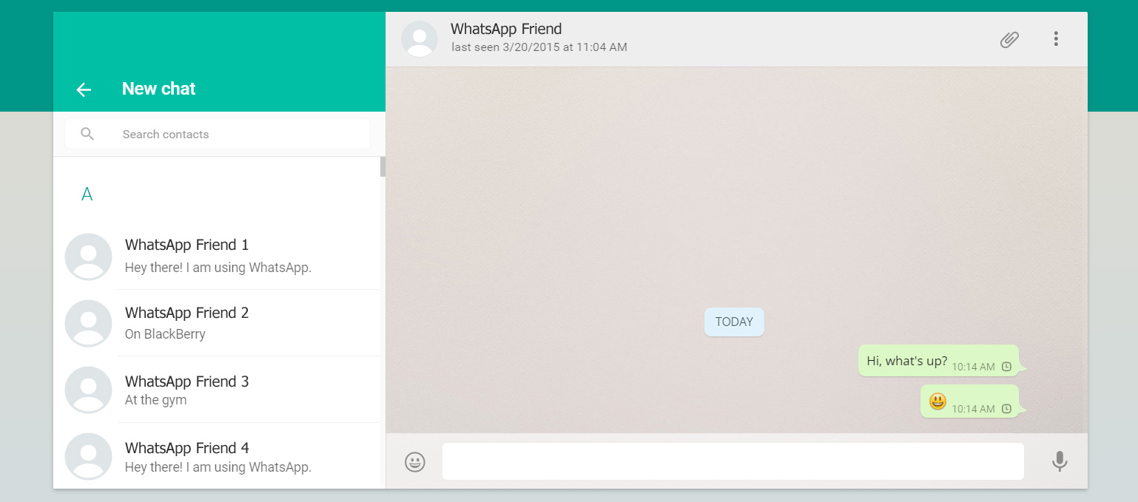

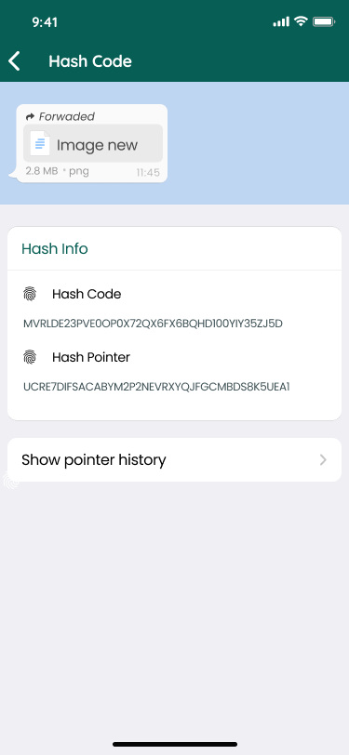
Tracing origin of Social Media Post
PSID: INTL-DA-08
TEAM LEADER: TRIJUN.M

Slide 2

Idea Introduction
Idea Outcome
Tech Stack
Angular
Ethereum
MongoDb
Resources Used
MetaMask
IPFS
Our objective is to create an accountability to every user who shares a forwarded message through Blockchain Technology so as to avoid sending abusive messages which creates easy identification of the origin of the media post.
Any third party API/Services?
No

Slide 3
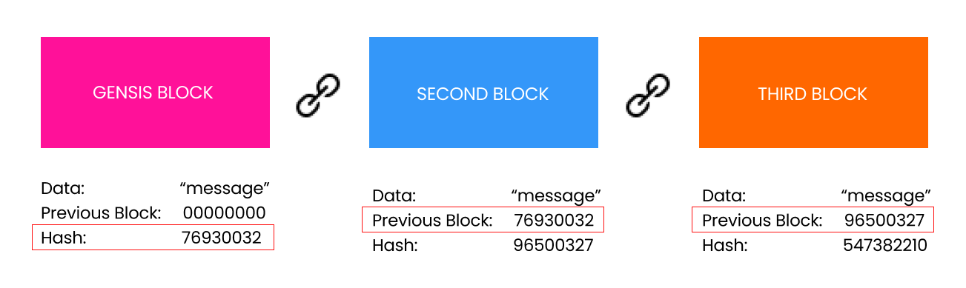
Approach Towards Idea
With the power of blockchain, every message that is forwarded would be storing the sender’s hash id which can be used to give the users a sense of accountability to avoid forwarding fake or abusive messages

Slide 4
Solution to the problem Statement
Forwarded messages don’t have accountability which leads to the problem of forwarding it too many times. So to stop this from happening we have created a way of identifying the senders through hash code which can be found by selecting the message and clicking on the hash info option on the top right corner.This displays the hash code as well as the hash pointer of that message.
Hash code refers to the unique identification code for the selected message and Hash pointer refers to the hash code of the user that forwarded the message.By this feature, every user knows that he will be accountable whenever they forward a message. This stop and helps us to identify every person to which it has been sent as well as easy identification of the source.

Slide 5
Features
At present, to find the person who sent an abusive content in the first place will take a lot of time by which the number of times it would have been forwarded would be sky high.
This problem is what we have solved by implementing blockchain technology through which an hashcode is generated for each and every message that is created in the app.
Therefore anytime a message is forwarded, it creates a chain of accountability through blockchain technology. This helps us to identify every person to which it has been sent as well as the sender using hash pointer.

Slide 6
Future scope
We would also add the feature to directly stop the person from sending by reporting the hash code of the origin post.
If the number of reports increase a certain limit will automatically lead to identifying the data on the block and deleting it from the entire block chain which will stop further forwarding of the abusive message

Slide 7






Team Members
Team Leader
Team Member
Team Member
Team Member
Team Member
Team Member
TRIJUN.M
THIRUMKUMARAN.R
SAKTHI.V
SESHA KRISHNAN.M
SHARUCK.J
MOHAMED SHAHITH

Slide 8
Development Pipeline
Proposed Development Plan in pointers
Documents To be prepared for installation and evaluation
Repository Link or Any references link of folder
Proposed UI and functional flow in pointers
1.Implement blockchain technology
2.Create a method to generate hash codes for every message
3. Store the hash info in the blockchain every time a message is forwarded
1. Angular CLI installation
2. Remix Ehterium installation
3. MongoDB installation
1. Figma prototype link
https://www.figma.com/file/skuUa5Wp9mibQ2wuV4uCi0/Untitled?node-id=0%3A1
1.Implement blockchain technology
2.Create a method to generate hash codes for every message
3. Store the hash info in the blockchain every time a message is forwarded

Slide 9
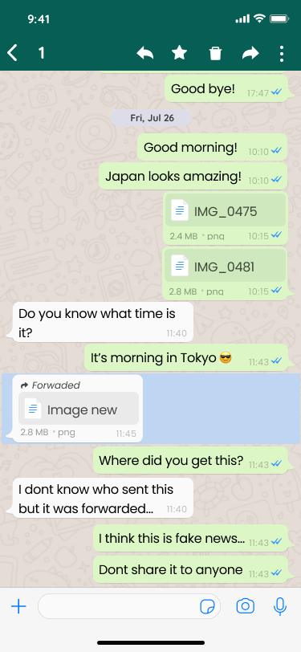
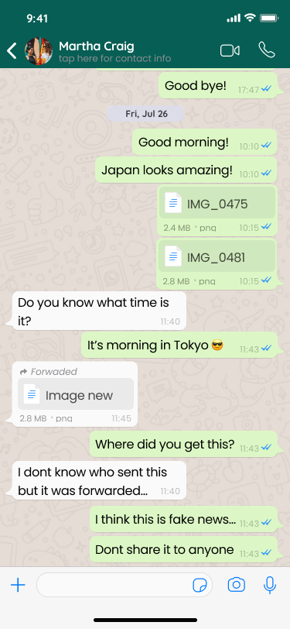

Component Browser
Prototype Design
Displays all the hash info
Balsamiq Tip | Use the Balsamiq add-on to make your own wireframe.

Slide 10
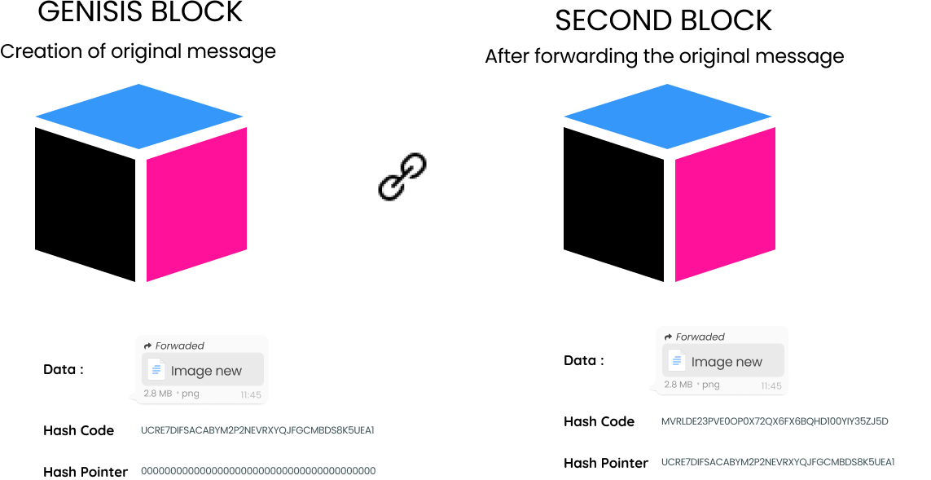
SYSTEM ARCHITECTURE
In the previous screens, we can see that the hash id and the pointer of the selected message.
By using this information, we can also identify the previous sender which will eventually lead to the genesis block i.e the original sender

Slide 11
Prototype Model
https://www.figma.com/proto/skuUa5Wp9mibQ2wuV4uCi0/Untitled?node-id=6%3A1751&scaling=scale-down&page-id=0%3A1&starting-point-node-id=16%3A149&show-proto-sidebar=1

